Slide 1
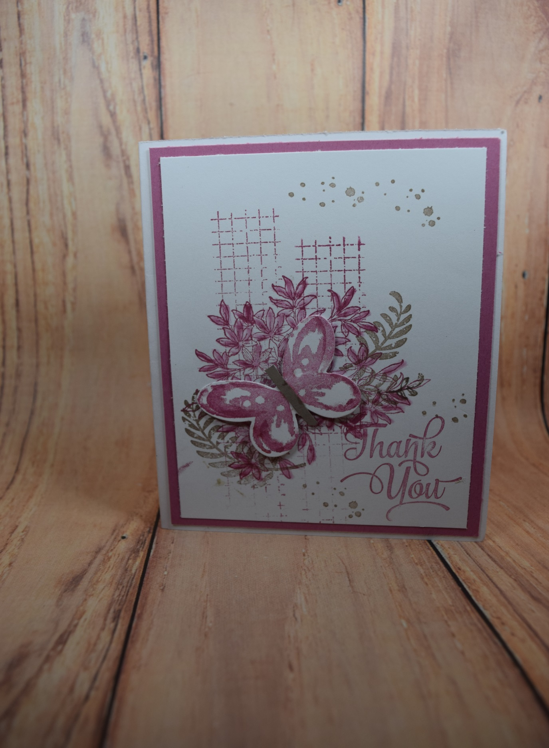
Timeless Texture
Awesomely Arrtistic
Waatercolor Wishes
One Big Meaning

